Slide 1

ATLIQ MART
SALES & PROMOTIONAL ANALYSIS
Codebasics resume Project Challenge 9
By:
Isha Arora
-Aspiring Data Analyst

Slide 2

CONTENT
Introduction
Goals
Analysis
Recommendation

Slide 3
ATLIQ MART
AtliQ Mart is a retail giant with over 50 supermarkets in the southern region of India.
All their 50 stores ran a massive promotion during Diwali 2023 and Sankranti 2024 (festive time in India) on their AtliQ branded products.
The sales Director is now interested in understanding the promotion behaviors with respect to the revenue generated during this period.

Slide 4

GOALS
Understanding Business
Creating a Dashboard Report
Implementing Ad-hoc Requestd for Business Decision-Making
Providing Recommendations to the Sales Director

Slide 5



STORE PERFORMANCE ANALYSIS

Slide 6

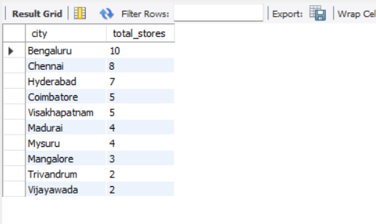
USEFUL INSIGHTS FROM THIS ANALYSIS
The top 10 stores in IR are in the cities of Bangalore, Chennai, and Hyderabad.
The cities with the highest revenue are the Tier 1 cities in India. The reason for this might be, the growth of the moving population due to employment opportunities in these cities. Also, these cities have a higher number of stores.

Slide 7
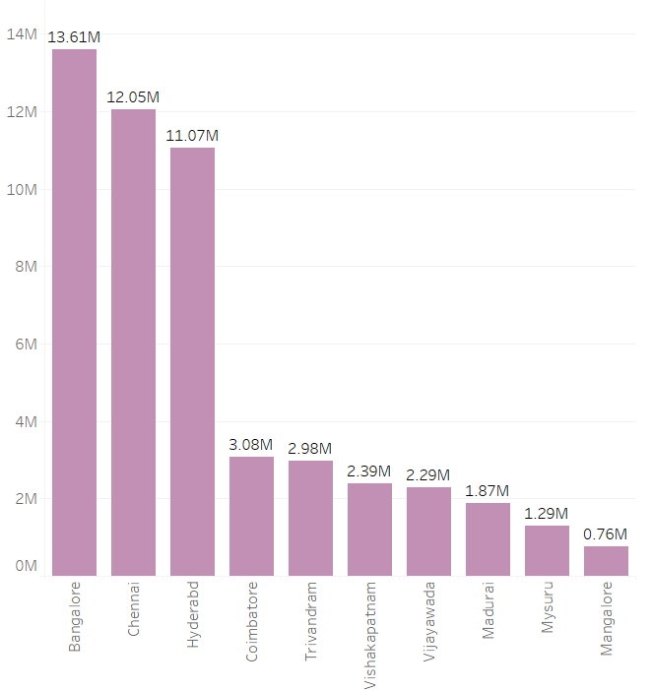
USEFUL INSIGHTS FROM THIS ANALYSIS
City Wise Population
The lowest Incremental Sold Units is the Store in Mangalore with only 1.95K. Other stores include in cities of Trivandrum, and Vizag.

Slide 8


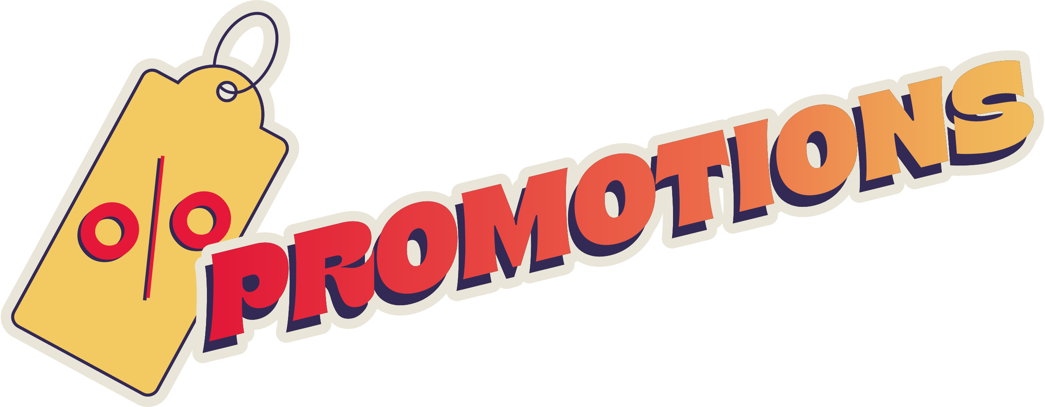
PROMOTION TYPE ANALYSIS
Top 2 promotion types that resulted in the highest Incremental Revenue
Bottom 2 promotion types in terms of Incremental Sold Units
Is there any significant difference between various promo types in terms of performance
Which promotion strikes the best balance between ISU and margins

Slide 9
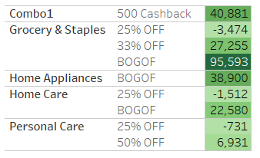
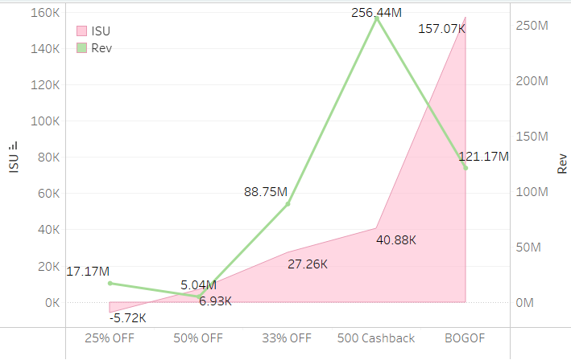
INSIGHTS FROM PROMOTION ANALYSIS
Buy one Get one free has seen a substantial increase in Sold Units after promotions
500 cashback and 33% off have also performed well, however, 25% off has negatively impacted the sales.
In terms of Incremental Revenue, BOGOF and 33% off have performed exceptionally well.

Slide 10
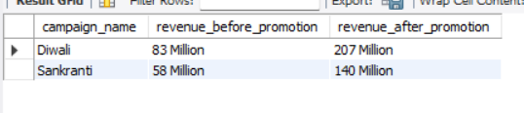
INSIGHTS FROM PROMOTION ANALYSIS
As we can see, there has been a notable increase in revenue after promotions held during Diwali and Sankranti which is 149% and 141% respectively

Slide 11



PRODUCT & CATEGORY ANALYSIS
Which products saw the most significant lift in sales during the promotion
Are there any products that performed exceptionally well or poorly in promotions?
What is the correlation between product categories? and promotion-type effectiveness

Slide 12

INSIGHTS FROM PRODUCT ANALYSIS
Products that performed very well after the promotion: Atliq Farm Chakki Atta, Home Essentials, Sonamansuri Rice, and Sunflower Oil
The lowest Revenue Generated during the promotion period is by personal care items.
Apart from that, 80% of the Revenue comes from 20% of the products and they are Farm Chakki Atta, Sonamansuri Rice, and Home Essential Combo

Slide 13
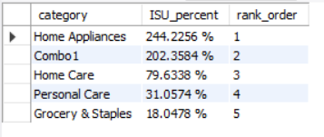
INSIGHTS FROM PRODUCT ANALYSIS
Overall Groceries and Staple Foods have seen the highest Incremental Sold Units with 119.37 Quantities Sold.
Sankranti- Grocery contributed to more than 80% of the sale
However, in Diwali Home Appliances Category has seen a 244% increase in Incremental Sold Units making Grocery with only an 18% rise in ISU

Slide 14
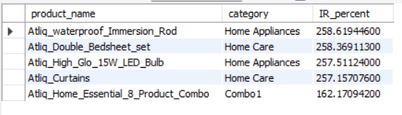



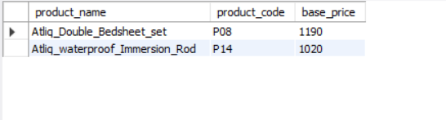
INSIGHTS FROM PRODUCT ANALYSIS
This query shows the list of the products that had a price of more than 500 and were promoted as Buy One Get One Free.
This query shows the top 5 products that generated the most Incremental Revenue including both the promotions.

Slide 15


RECOMMENDATIONS FOR ATLIQ MART
Recommendation on Promotion Types
Understanding Products and thier Performance
Campaign Effectiveness Analysis
Geographic Presence Recommendation

Slide 16

THANK YOU
For your attention
I would like to thank you the entire Codebasics Team for being the inspiration of completing this project.

